Slide 1

Automata Theory Lecture: 9 Kleene’s Theorem
Farhad Muhammad Riaz

Slide 2
Kleene’s Theorem
Unification
Turning TGs into Regular Expressions
Converting Regular Expressions into FAs
Nondeterministic Finite Automata
NFAs and Kleene’s Theorem

Slide 3
Unification
We have learned three separate ways to define a language: (i) by regular expression, (ii) by finite automaton, and (iii) by transition graph.
Now, we will present a theorem proved by Kleene in 1956, which says that if a language can be defined by any one of these three ways, then it can also be defined by the other two.
In other words, Kleene proved that all three of these methods of defining languages are equivalent.

Slide 4
Theorem
Any language that can be defined by regular expression, or finite automaton, or transition graph can be defined by all three methods

Slide 5
Kleene’s Theorem
This theorem is the most important and fundamental result in the theory of finite automata.
We will take extreme care with its proofs. In particular, we will introduce four algorithms that enable us to construct the corresponding machines and expressions.
Recall that
– To prove A = B, we need to prove (i) A B, and (ii) B A.
– To prove A = B = C, we need to prove (i) A B, (ii) B C, and (iii) C A.

Slide 6
Kleene’s Theorem
Thus, to prove Kleene’s theorem, we need to prove 3 parts:
Part 1: Every language that can be defined by a finite automaton can also be defined by a transition graph.
Part 2: Every language that can be defined by a transition graph can also be defined by a regular expression.
Part 3: Every language that can be defined by a regular expression can also be defined by a finite automaton.

Slide 7
Proof of Part 1
This is the easiest part.
From previous lecture, we know that every finite automaton is itself already a transition graph. Therefore, any language that has been defined by a finite automaton has already been defined by a transition graph.

Slide 8
Proof of Part 2: Turning TGs into Regular Expressions
We prove this part by providing a constructive algorithm:
Every TG has a regular Expression.
We present an algorithm that starts out with a transition graph and ends up with a regular expression that defines the same language.
To be acceptable as a method of proof, the algorithm we present will satisfy two criteria: (i) It works for every conceivable TG, and (ii) it guarantees to finish its job in a finite number of steps.

Slide 9
Creating A Unique Start State
Consider an abstract transition graph T that may have many start states.
We can simplify T so that it has only one unique start state that has no incoming edges.
We do this by introducing a new start state that we label with the minus sign, and that we connect to all the previous start states by edges labeled with Λ. We then drop the minus signs from the previous start states.
If a word w used to be accepted by starting at one of the previous start states, then it can now be accepted by starting at the new unique start state.
The following figure illustrates this idea.

Slide 10
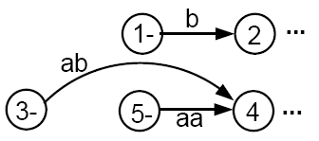
Example
Consider a fragment of T:
The above fragment of T can be replaced by

Slide 11
Creating a Unique Final State
Let us make another simplification in T so that it has a unique, unexitable final state, without changing the language it accepts.
If T had no final state, then it accepts no strings at all and has no language. So, we need to produce no regular expression other than the null, or empty, expression Φ(see page 36 of the text).
If T has several final states, we can introduce a new unique final state labeled with a plus sign. We then draw new edges from all the former final states to the new one, dropping the old plus signs, and labeling each new edge with the null string.
This process is depicted in the next slide.

Slide 12
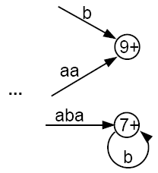
Example

Slide 13


Combining Edges
If T has some internal state x (not the - or the + state) that has more than one loop circling back to itself:
where r₁, r₂, and r₃ are all regular expressions or simple strings.
We can replace the three loops by one loop labeled with a regular expression:

Slide 14

Combining Edges
Similarly, if two states are connected by more than one edge going in the same direction:
We can replace this with a single edge labeled with a regular expression:

Slide 15

Bypass and State Elimination
If T has 3 states in a row connected by edges labeled with regular expressions or simple strings, we can eliminate the middle state, as in the following examples:
Can be replaced with

Slide 16

Bypass and State Elimination
If the middle state has a loop, we can proceed as follows:
Can be replaced with

Slide 17
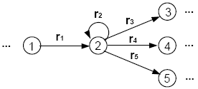
Bypass and State Elimination
If the middle state is connected to more than one state, then the bypass and elimination process can be done as follows:
Can be replaced with

Slide 18
Special Cases
Can be replaced with

Slide 19
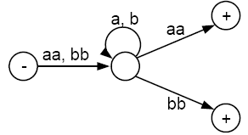
Example
Consider the following TG that accepts all words that begin and end with double letters (having at least length 4):

Slide 20
This TG has only one start state with no incoming edges, but has two final states. So, we must introduce a new unique final state:

Slide 21
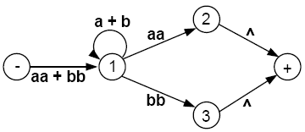
Now we build regular expressions piece by piece:

Slide 22
Eliminate state 2:

Slide 23
Eliminate state 1:

Slide 24
Eliminate state 3:

Slide 25
Hence, this TG defines the same language as the regular expression
(aa + bb)(a + b)*(aa) + (aa + bb)(a + b)*(bb)
or equivalently
(aa + bb)(a + b)*(aa + bb)
If we eliminated the states in a different order, we could end up with a different-looking regular expression. But by the logic of the elimination process, these expressions would all have to represent the same language.
We are now ready to present the constructive algorithm that proves that all TGs can be turned into regular expressions that define the exact same language.

Slide 26
Algorithm
Step 1: Create a unique, unenterable minus state and a unique, unleaveable plus state.
Step 2: One by one, in any order, bypass and eliminate all the non-minus or non-plus states in the TG. A state is bypassed by connecting each incoming edge with each outgoing edge. The label of each resultant edge is the concatenation of the label on the incoming edge with the label on the loop edge (if there is one) and the label on the outgoing edge.
Step 3: When two states are joined by more than one edge going in the same direction, unify them by adding their labels.
Step 4: Finally, when all that is left is one edge from - to +, the label on that edge is a regular expression that generates the same language as was recognized by the original TG.

